Slide 1

Nutrition Programs:
Meal Site Coordinator Foundations

Slide 2
Learner Objectives
Understand how nutrition programs are funded & structured
Identify Focus Areas important to Meal Site Coordinators
Identify Focus Area tasks for which Coordinators are responsible
List steps necessary to complete identified tasks
Create a timeline for ensuring, on-time task completion
Identify methods for ensuring timely, effective communication with members of the Board
Plan methods for providing quality training for staff & volunteers

Slide 3



Nutrition Program Authority & Funding Flow
Older Americans Act
(OAA) Nutrition Program
for Older Adults
Administration for Community Living (ACL)
Idaho Commission on Aging (ICOA)
AAA
Area Agency on Aging (AAA)
Meal Site
Nutrition Programs

Slide 4



OAA Nutrition Program Goals
  Reduce hunger & food insecurity, malnutrition
  Promote socialization
  Delay onset of adverse health conditions

Slide 5


Basic Program Participant Eligibility Criteria
CM
HDM
  Age 60+
  Age 60+
  Homebound
  Frail
  Unable to prepare meals at home
  Other, based on each AAA

Slide 6
Program Participant Eligibility Continued
If there is a waiting list in place or to foresee soon, additional eligibility requirements may be implemented. Meal Provider needs to work closely with AAA and follow all guidelines.

Slide 7
Meal Site Coordinator Focus Areas
Focus Area 1: Health District permit-license to operate a meal site
Focus Area 2: Food establishment inspection
Focus Area 3: 501 (c)3 status through IRS determination letter
Focus Area 4: Accredited food protection manager training certification
Focus Area 5: Congregate meal registration form and nutritional health risk survey
Focus Area 6: Rosters and/or sign in sheets for participants, visitors and volunteers
Focus Area 7: Donations & donation box placement
Focus Area 8: Donation tracking sheet
Focus Area 9: Nutrition education at
meal sites
Focus Area 10: Invoicing for reimbursement
Focus Area 11: Knowledge of Nutrition Services Incentive Program (NSIP) funds
Focus Area 12: Knowledge of additional nutrition guidance
  Commodity Donated Food Program
  Eligible / Ineligible Participant
  Home-Delivered Meal Program Compliance
  Voluntary Contributions
  Meal Frequency Waiver
Focus Area 13: Knowledge of the role of the Board and what they should know about the nutrition program
Focus Area 14: Menu approval
Focus Area 15: Training to volunteers and staff

Slide 8

Why We Need a Permit-License
Complies with Idaho law
(Review Idaho Food Code )
Ensures food & facility safety
Includes establishing, operating & maintaining
a food establishment

Slide 9
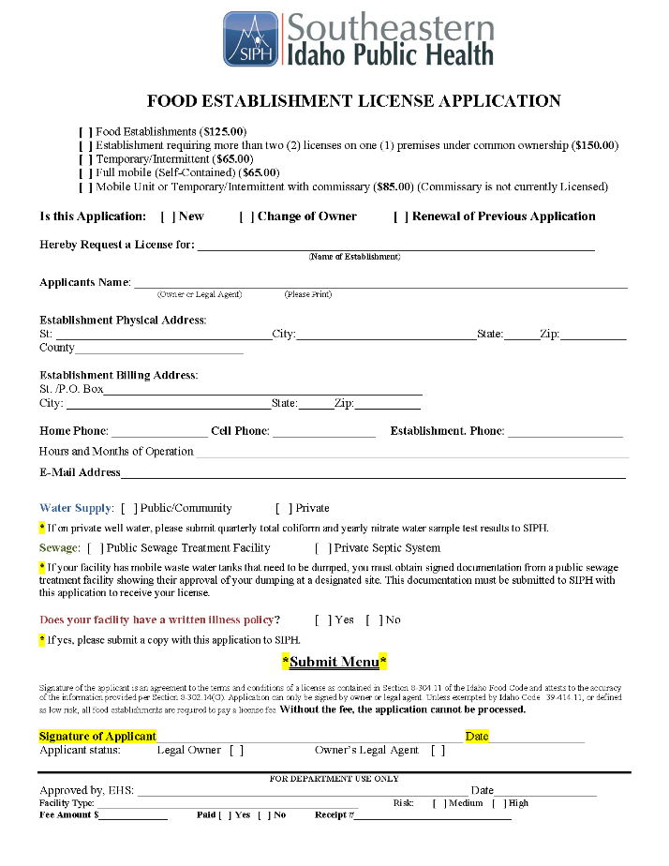
What the Permit-License Requires
Completed application for local Health District
Required supporting documentation
Site inspection

Slide 10

When We Need the Permit-License
Before opening for service
Renew annually (every year)
  Check with local Health District for specific notification procedures
  Notification generally sent via regular mail either in the fall or prior to your annual renewal date
  Annual cost is around $125

Slide 11
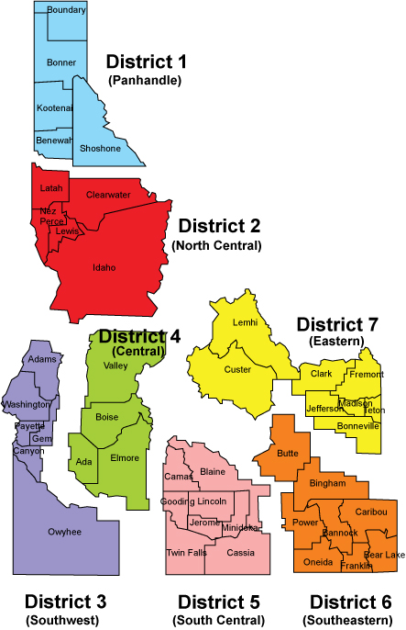
How to Apply for the Permit-License
Application available through local Health District
Instructions on application
Complete all fields
Include all requested documentation
Common errors:
  Check the appropriate permit type
  Include the
  proper fee

Slide 12
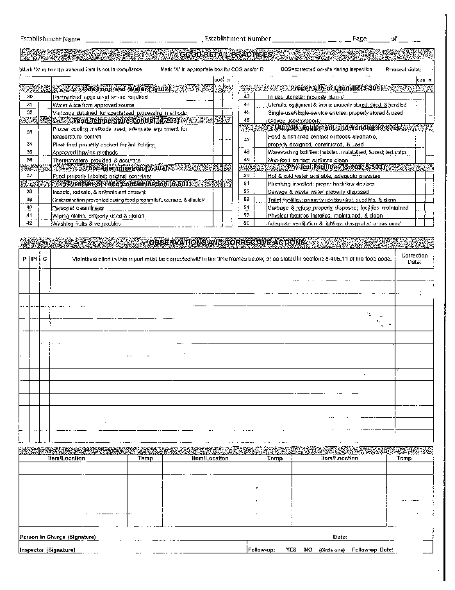
Why We Need an Inspection
Complies with State food safety regulations
Helps preventing food-borne illness
Ensures safe, sanitary setting
for staff, volunteers &
consumers

Slide 13
When Inspection Occurs
Part of initial permit-license process
Health District can perform unscheduled inspections
at any time, for any reason, usually yearly
If inspection fails, a corrective action plan may be employed by the Health District to provide opportunity to remedy deficiencies

Slide 14
How to Work with Inspections
Facilitate all Health District safety &
sanitation inspections
Consistently maintain all
standards
Modify site or procedures to
comply with recommendations
Retain inspection reports &
corrective action plans
Inspection report should be visible in the kitchen area

Slide 15
Why We Need 501 (c)3 Status
Official recognition as non-profit organization
Saves money & administrative/record-keeping time
Provides exemption from federal, sales & property taxes
Offers exemption from payroll taxes on employees
Certain Grant money applies only to non-profits

Slide 16
What 501 (c )3 Status Requires
Application, updates & changes handled through
the IRS
Application requires significant information & documentation
Best practice: If possible, work with a tax accountant & be sure s/he provides a review at least annually
Preparation & approval can take up to one year
Review the Internal Revenue Service’s charities & non-profits pages for additional information
The Difference Between For Profit and Nonprofit Organizations
(Dr. Kenneth Acha)
URL: https://youtu.be/Zw9j1g1wsq8
Time: 3:24

Slide 17
How To Apply for 501 (c)3 Status
Existing facilities may already have this status
Application can take up to 100 hours to complete
If participating in application process:
  Review IRS Publication 4220
  Gather & prepare corporate documents
  Work with your organization Board & accountant
Receive Determination letter
when approved
Video title: How to Start a Nonprofit
(Nonprofit Ally)
URL: https://youtu.be/UaiKlOTRH2M
Time: 4:47

Slide 18
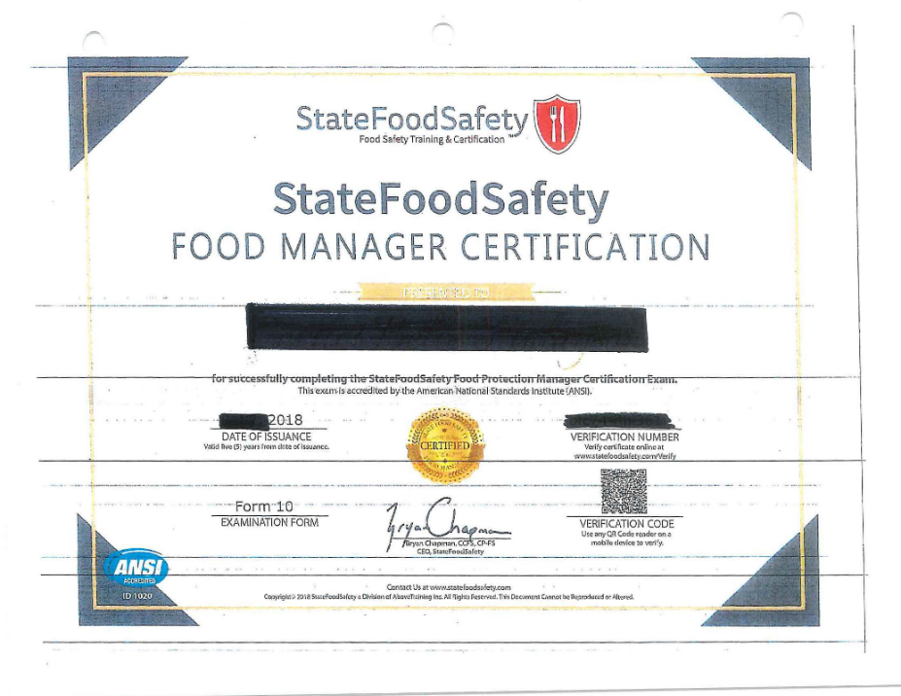
Why Manager Certification is Necessary
Required by Health & Welfare since 7/1/2018
(Idaho Food Code, paragraph 2-102.12(A) )
State certified Food Protection Manager (“Manager”)
oversees food production
On-site during operating hours or ensures someone as equally
qualified (but not
necessarily certified)
Certified person trains
food handlers
Ensures adherence to
food handling & safety
procedures

Slide 19
What Idaho Requires for Managers
(IDAPA 16.02.19.201)
Have supervisory authority to direct & control food
preparation activities
Have supervisory authority to correct food safety violations
Have successfully completed a nationally accredited food safety examination provided by a recognized vendor:
  360 Training ®
  Above Training/State Food Safety®
  National Registry of Food Safety Professionals®
  Prometric (testing only, no prep)
  SERV Safe® (National Restaurant Association)
Managers must be recertified every 5 years
For more information, refer to Accredited Food Manager Guidance

Slide 20
How to Prepare for the Exam
Up to the individual
Vendor-specific study materials can be found online
360 Training
SERV Safe
Cost for study materials and/or test preparation varies by vendor
View this video duration 5:19)
Search YouTube for “Basic Food Safety Course Central District Health” for other videos in this series

Slide 21
How to Register for the Exam
Exams can be taken :
Online
At testing center
As part of an instructor-led class
Register via vendor’s website
Follow instructions carefully
Exam cost is approximately $125

Slide 22
How Certification Happens
80 multiple choice test questions
(+10 demographic/research questions that do not count as
part of the exam)
60 correct (60/80 or 75%)to pass
Exam certified by SERV Safe
Valid for 5 years

Slide 23
How Retakes Occur
May re-take twice within 30 days
Must wait 60 days for 3rd attempt
Only 4 attempts allowed in 12-month period
Cost for re-takes varies, usually full price of exam

Slide 24
Why Collect Registrations & Surveys
Accurate counts of meals provided required
for program funding & meal site reimbursement
  AAA only reimburses for documented meals served to qualified consumers
  Federal funding based on reported data
  Registration form documents self-reported qualification confirmation
Meal site can offer nutrition counseling or referral
based on survey results

Slide 25
What the Registration Form Does
Registers qualified consumers & volunteers
Collects basic information including:
  Contact
  Eligibility for service (checkbox)
  Demographics
  Emergency contact
Registers for all Idaho meal sites
Includes person on roster
See Focus Area 6

Slide 26
Older Americans Act States
Services are not intended to reach every individual in the community. Programs target adults age 60 and older who are in greatest social and economic need, with particular attention to the following groups:
  Low-income older adults
  Minority older individuals
  Older adults in rural communities
  Older individuals with limited English proficiency
  Older adults at risk of institutional care

Slide 27
The Nutritional Health Survey
Completed with registration
Asks 10 yes/no questions
Each has score for a “yes” answer
Total score gives suggestions for
possible follow-up
  Individual on their own
  Coordinator
  Physician or Dietician with the person
  With permission, may speak with
  a family member
2nd page has explanations of how the
areas affect nutrition
Consumer score >=6 can request
nutrition counseling from Dietitian

Slide 28
When We Need Registration
New consumers
Disenrolled consumers
Note: Consumers should be automatically disenrolled if not
active for a specified period of time, but latest after 12 months.

Slide 29
How to Complete a Registration
All consumers 60+ years old should complete a
registration form & survey to register
Volunteers should register so their meals can be reimbursed, if funding allows
Refusal to register does NOT prevent a qualified person
from receiving a meal, they are treated as a visitor
Best practice: One-time visitors who are 60+ years should complete the registration so they can be counted & their meal reimbursed by the AAA
Submit registrations to AAA per their requirements

Slide 30
Why We Need Rosters & Sign-In Sheets
Provides required data for everyone 60+
including volunteers
Basis for monthly invoices
Required for participation reporting, program
funding & reimbursement
Reported to State Legislature & ACL
Sign-in sheets document non-qualified and those who refuse to register

Slide 31
When We Need Rosters & Sign-in Sheets
Rosters should be received electronically from AAA
prior to the start of the month
Should be used to capture participation at
each service
Specific reporting requirements determined by AAA
Generally submitted at least monthly
Ask AAA Nutrition Program staff to clarify questions

Slide 32
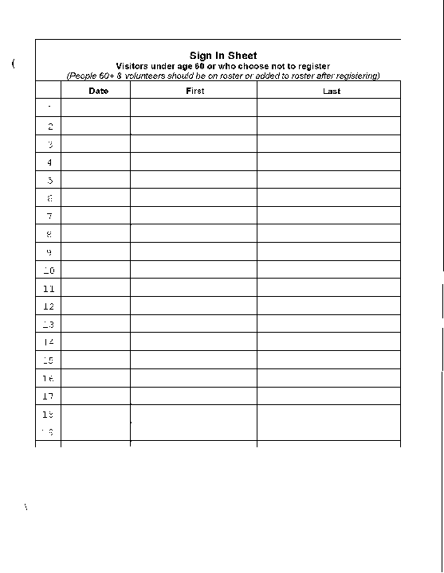
How to Complete Rosters & Sign-in Sheets
Use rosters to check-in previously registered
consumers & volunteers
Write- in names of people who register for the first time at of the roster
Indicate their participation
for the current meal
Sign-in sheets
  People <60 or refuse to register
  Meal site can charge
  people <60 for the meal
  unless Idaho Food Bank
  commodities used, then
  cannot charge

Slide 33
How to Submit Documentation
Submit per AAA instructions
Include:
Completed invoice
Supporting rosters with meal counts for each person
In-kind, program income
Keep detailed documentation for 7 years:
Rosters & sign-in sheets
Deposit documentation
Volunteer timesheets

Slide 34
Why Follow Donation Guidance
Ensures everyone understands donations:
Are voluntary
No meal is ever denied based on a person’s choice to donate or not
Establishes donor privacy & confidentiality
Relieves consumer concern that donations are being monitored
Provides staff & volunteers confidence that they are adequately prepared to work with donations

Slide 35
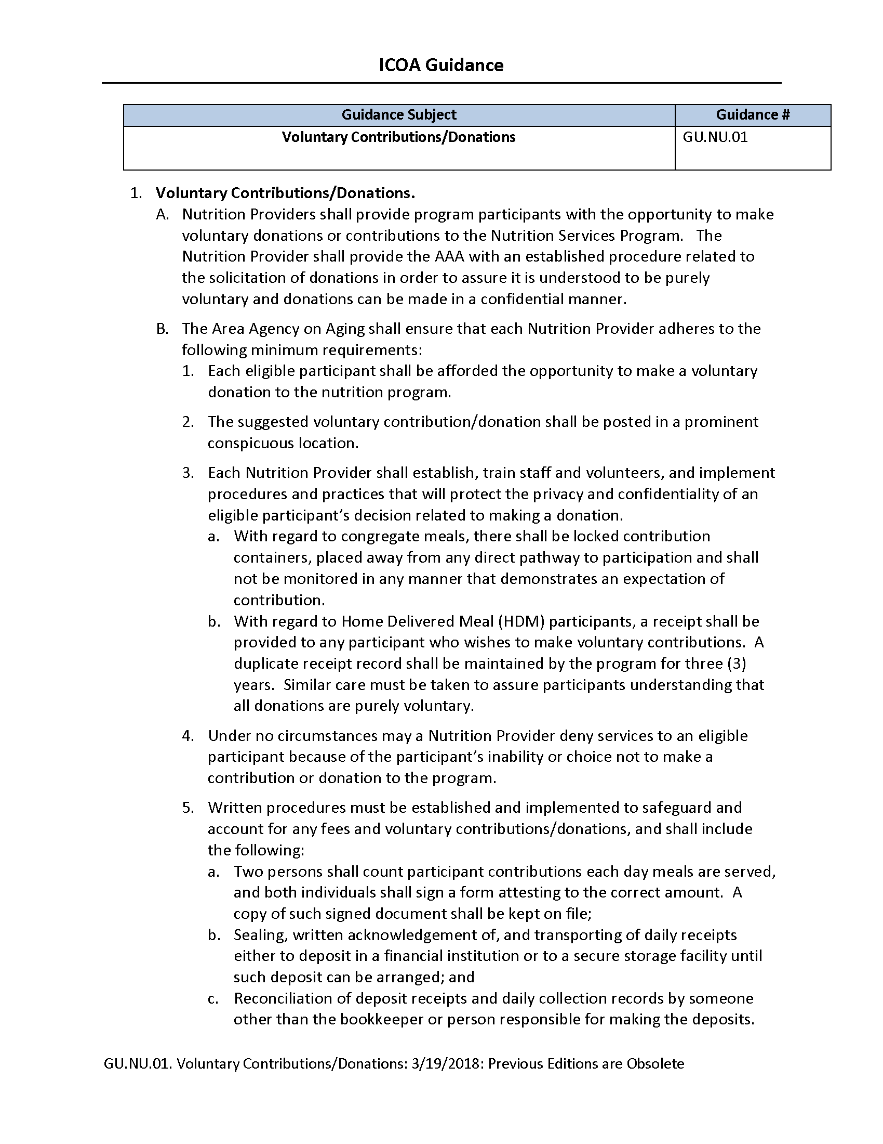
What Correct Donation Acceptance means
Following Voluntary Contributions/Donations
Guidance (GU.NU.01)
Train staff & volunteers
how to protect privacy &
confidentiality of consumers
decision related to donating.

Slide 36
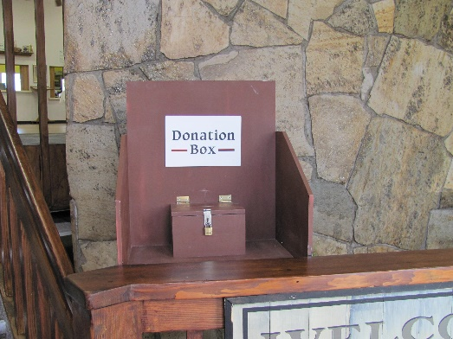
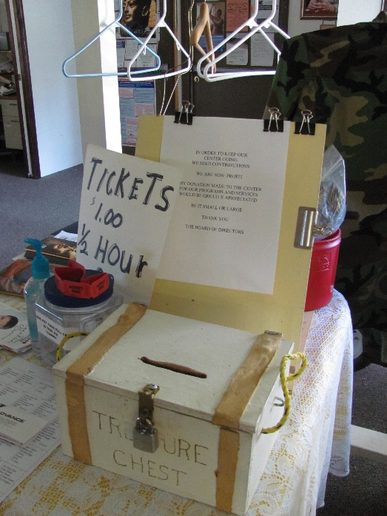
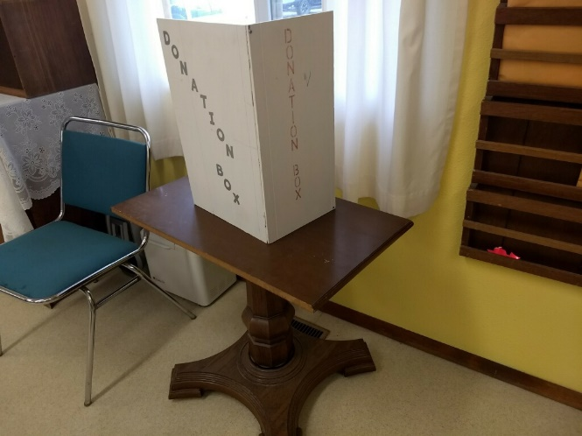
Which Image(s) Follow Guidelines?

Slide 37
How to Ensure Proper Donation Processes
For each service:
“Under no circumstances may a nutrition provider deny services to an eligible consumer because of the consumer’s inability or choice not to make a contribution or donation to the program.”
Donation box properly placed & secured
Voluntary contribution amount clearly posted
Staff & volunteers properly trained on donation guidance &
approved procedures
Privacy provided

Slide 38
Why Complete Donation Tracking Sheets
Donations will support nutrition programs
Donation totals included with monthly invoice
Reported to ICOA
Reported to State Legislature & ACL

Slide 39
What Should Be Tracked
All Nutrition Program donations
All forms of payment
Cash
Checks
SNAP

Slide 40
When to Count Donations
Recommended after each service
Daily totals are best practice
Monthly totals required with invoice

Slide 41
How to Complete Donation Tracking Sheets Recommendation
Voluntary Contributions/Donation Guidance
Written procedures established & implemented
safeguard & account for fees & donations:
Two persons count each day
Both sign a for correct amount
Copy kept on file
Sealed daily & deposited or secured until deposited
Deposit receipts reconciled by someone other than person responsible
for making deposits
All funds with documentation reported to Coordinator who
Seals the donations
Checks for written acknowledgement
Makes the deposit

Slide 42
Idaho Foodbank Food and Donations
If you cook with foodbank food (does not matter the amount little or a lot) you cannot charge/request money from anyone even under 60 years (this has always been this way).
There is no one day cooking with and one day without foodbank food. Either you signed up to cook with foodbank food or you did not sign up.
You all are allowed either way to have suggested donation signs to the services offered at the meal site including a $ amount.

Slide 43
Why Provide Nutrition Education
Required of programs funded by the OAA
Enhances health & wellbeing
Clarifies optimal nutrient intake concept
Engages clients using a variety of delivery methods
Takes advantage of face-to-face contact to increase
nutrition awareness
Notes:
OAA requirement to enhance health & wellbeing

Slide 44
What Nutrition Education Includes
Useful information about healthy eating &
lifestyle choices
Food-related topics including shopping, selection, preparation
storage, micro/macronutrient & alternative choices
Physical activity
Holistic wellness
Provided in any useful format
Provides knowledge, skills & attitudes that assist consumers in improving their health & wellbeing
Notes:
Information about nutrition & general health

Slide 45
When to Provide Nutrition Education
Lunchtime
Handout
Required monthly
Preferred is that HDM participants will get a printed nutrition education flyer with their meal once a month

Slide 46

How Education Can Be Presented
Nutrition flier
30-minute presentation
Brochure
Lunch talk
Cooking class
Fresh produce shopping with Dietitian
Write a recipe with Dietitian
Use your imagination!
Make it engaging!

Slide 47
How to Provide Nutrition Education
Several sources of content:
Dietitian
AAA
ICOA
Reliable source
choose my plate.gov
US Department of Agriculture
Document date, times & materials used
Include information on that month’s Invoice to the AAA

Slide 48
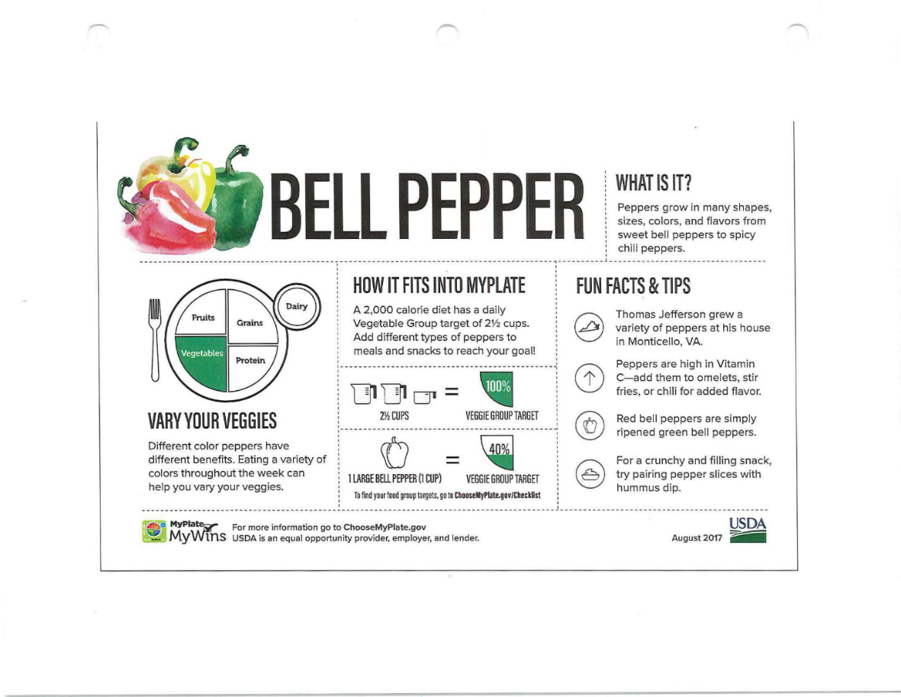
ChooseMyPlate.gov Food Identification, Use & Nutritional Value Sample

Slide 49
Why Submit Invoices
Meal sites want reimbursement from
contracting AAA
Request for reimbursement & supporting documentation required by AAA

Slide 50
What Invoicing Involves
Invoices are formal request for reimbursement
Include all necessary information
Meal site identification
Dates
Quantities
Prices/Costs
Supporting documentation might include:
Rosters
Total in-kind match & program income
Nutrition education materials

Slide 51
When Invoices Are Due
Submit to AAA on time that is determined by the AAA
Includes information for the entire prior month

Slide 52
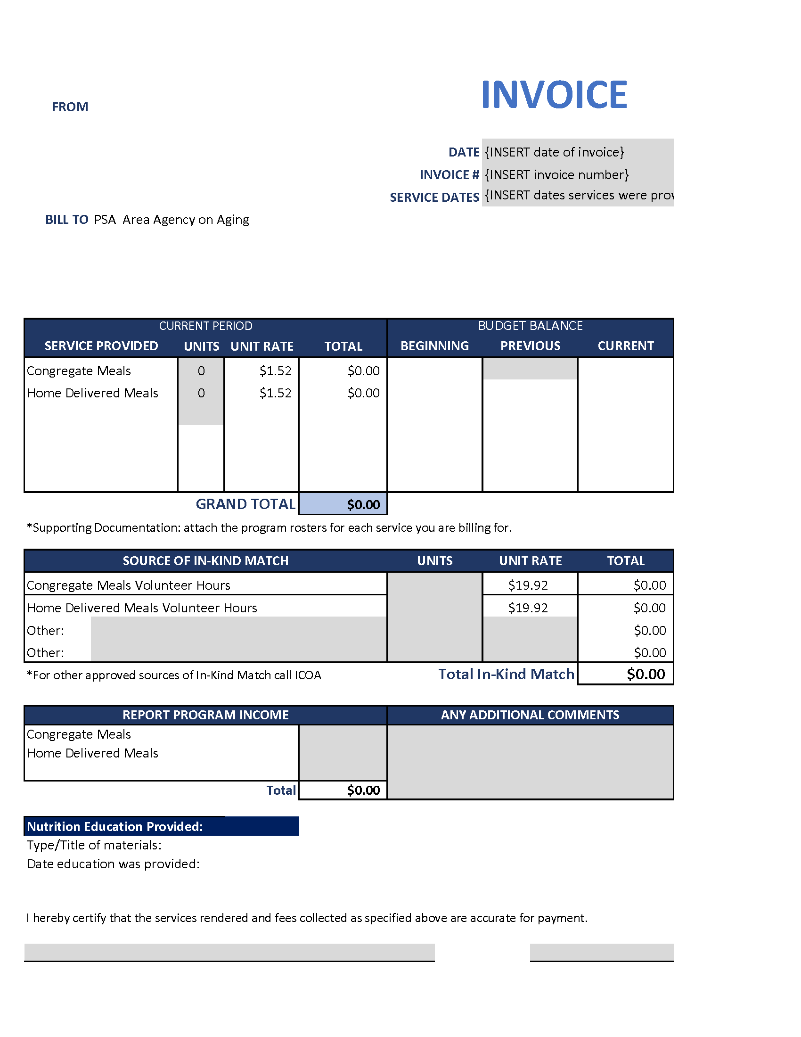
How Invoices Are Completed
Best practice: All invoice items should have supported
documentation
Use the Invoice template provided on ICOA website
Shaded areas are input fields
Include the following:
  Date
  Invoice number
  Dates of service
  Relevant units & rates/costs
  Enter beginning, previous & current
  budget balance
  Volunteer hours & total value
  Program income
  Type & title of education
  Date education provided

Slide 53
Why NSIP is Important
Provides federal funding to local programs
Based on meals served the prior year
Funds received 3-5 times per year
“To encourage & reward effective performance & efficient delivery of nutritious meals to older individuals”

Slide 54
What NSIP Funding Requires
Accurate recordkeeping of meals served
Accurate transfer to appropriate reports
On-time reporting to AAA monthly
NSIP uses the Federal fiscal year, which runs 10/1 – 9/30
(not the calendar or State fiscal year)
Funds can only be used to purchase domestically
produced food

Slide 55
What Changes Can Be Made
Final report due 10/30
Changes to counts must be provided
to AAA no later then 11/10
As soon as possible include
Date change was requested
Description of change
Reason for change

Slide 56
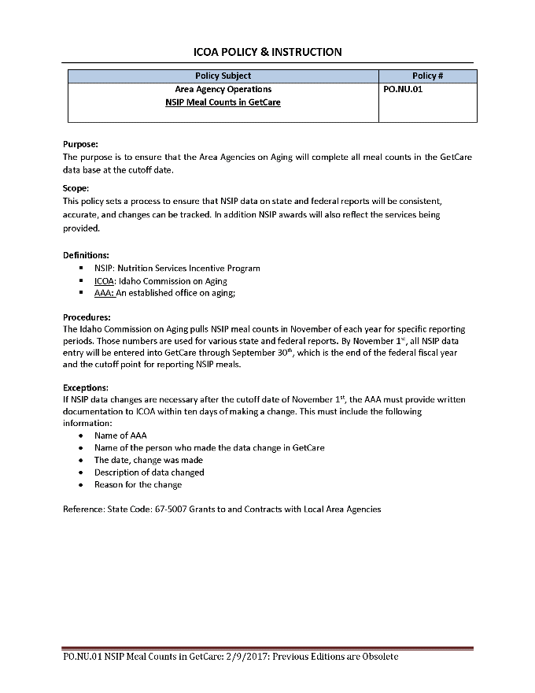
How to Participate in NSIP
Double-check all calculations in monthly reporting
Provide accurate final counts to AAA by 10/30 each year
If changes are necessary, report to AAA within 10 days & provide all requested information about the change
Use NSIP funds to purchase
domestically produced food
Build program & number of meals
served each year through this
incentive program
Refer to Guidance for details
For-Profits are excluded to receive NSIP

Slide 57
What Nutrition Guidance Includes
Most daily activities directed & managed by
the site
Guidance provides succinct listing of important program policies
ICOA guidance addresses four areas related to meal sites:
Commodity donated food
Consumer eligibility
Home delivered meals
Meal frequency waiver
Guidance may include:
Purpose
Requirements
Procedures
References

Slide 58
What Guidance's are available
(GU.NU.03.01)
(GU.NU.02)
(TG.NU.01)
Meal Frequency Waiver

Slide 59
Why Consider the role of the Board
Acknowledges oversight by Board of Directors
Informs the Board of significant issues or concerns,
as well as successes & goals
Provides assistance with corporate administration items like
non-profit status & reporting requirements
Assists with good communication, efficient management & growth of the meal site within the organization

Slide 60
What Needs to Be Known About the
Role of the Board
Follow direction provided in Manual for Non-Profits by
State of Idaho, Office of Attorney General Lawrence Wasden
Divided into 6 chapters:
  Service on Charitable Organizations
  Understanding a Board Members Role
  Need to understand the Nutrition Program &
  its Purpose
  Understanding a Board Members Rights
  Must be able to make informed decisions
  Understanding a Board Members
  Responsibilities
  Duties of care, Loyalty & Obedience
  https://legislature.idaho.gov/statutesrules/idstat/title30/t30ch30/sect30-30-617/liability

Slide 61
How to Interact with the Board
Make yourself known
Calendar the dates & plan to attend meetings
Prepare brief summaries of nutrition program activities
Ask to be added to their agenda for updates
Make sure all board members know how to contact you

Slide 62
Why Approve Menus
Complies with requirement for approval by registered Dietician or Nutritionist
Allows “second set of eyes” to review menu
Promotes balanced, nourishing meals for consumers based on the DGA
Notes:
Required by program

Slide 63
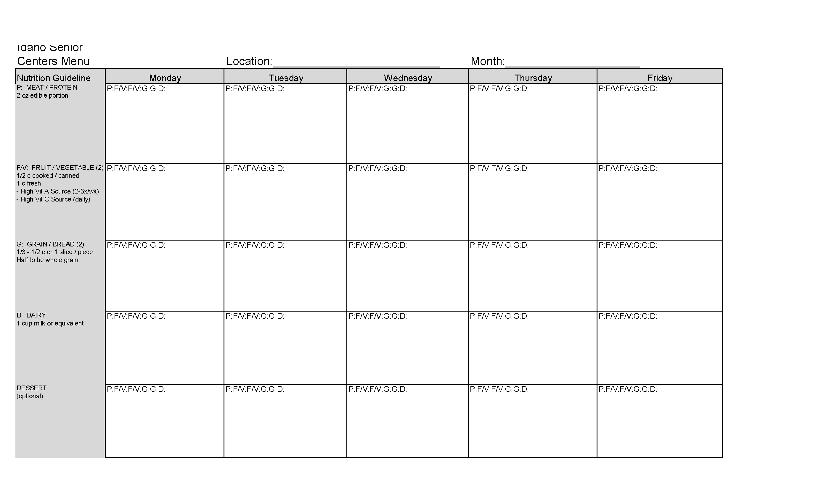
What Menu Approval Requires
Menus prepared by authorized kitchen staff
Completed menus reviewed by Dietician to ensure
nutritional quality
Dietician signs to indicate approval
Signed menus retained for reference & audit purposes

Slide 64
When Menus Should Be Approved
Minimum: One month prior to planned service
Required: Prior to serving
Connect with your dietitian for menu examples and how they should look like when submitted to dietitian

Slide 65
How Menus Are Approved
Use menu template provided by Dietician
Complete menu for the month, following template instructions
Submit to Dietician >30 days before first service from that menu
If menu changed:
Must be re-approved
Contact Dietitian
Get verbal approval
Send revised menu for written re-approval
Retain approved menus for your records

Slide 66
Why Train Staff & Volunteers
Assists compliance with site, program, State &
Federal requirements
Ensures staff & volunteers ability to provide services
  safely for themselves & others
Helps people feel valued & thrive in their position
Promotes sense of value to program & community

