Slide 1

Nutrition Programs:
Meal Site Check-in Clerk Training
Training

Slide 2
Learner Objectives
Understand how nutrition programs are funded & structured
Identify Focus Areas important to Meal Site check-in clerks
Identify Focus Area tasks for which check-in clerks are responsible
List steps necessary to complete identified tasks
Identify methods for ensuring approachable, responsive, effective communication with consumers
Understand the importance of accurate documentation. Adhere to program guidance

Slide 3



Nutrition Program Authority & Funding Flow
Older Americans Act
(OAA) Nutrition Program
for Older Adults
Administration for Community Living (ACL)
Idaho Commission on Aging (ICOA)
AAA
Area Agency on Aging (AAA)
Meal Provider
Nutrition Programs
Notes:
OAA, ACL, ICOA, AAAs and meal site structure
Understand how programs originated
Sources of funding
Who has oversight
Activities and reporting flow back and forth through this structure
Older Americans Act (OAA), Authorizes nutrition programs for older adults
Administration for Community Living (ACL), Where program authority and funding originates
Receives our reports, Provides funding to state agencies
Idaho Commission on Aging (ICOA)
Tasked with overseeing aging issues and programs
Contracts with six Area Agencies on Aging (AAAs), located throughout Idaho
AAA`s serve specific geographic area, contract directly with meal sites and oversee and communicate with meal sites and their Coordinators
Meal Site Coordinator manages meal site, staff and volunteers

Slide 4



OAA Nutrition Program Goals
  Reduce hunger & food insecurity and malnutrition
  Promote socialization
  to promote the health and well-being of older individuals by assisting such individuals to gain access to nutrition and other disease prevention and health promotion services to delay the onset of adverse health conditions resulting from poor nutritional health or sedentary behavior
Notes:
The OAA established the Administration on Aging within the Department of Health, Education and Welfare, and called for the creation of State Units on Aging. The Older Americans Act (OAA) was passed by Congress in 1965 as a response to policymaker concerns about the lack of services for older adults. The original act gave authority for grants to States for community planning, social services, research and development projects, and training on aging related issues.
Above I added a few very important requirements out of the OAA for your convenience.
The purposes of these programs are to 1) reduce hunger, food insecurity and malnutrition, 2) promote socialization, 3) promote health and well-being, and 4) delay adverse health conditions. The intent is to make community based nutrition services available to older adults who may be at risk of losing their independence and their ability to remain in the community.
If you are interested in the full version of the Older Americans Act, please go to the link www.acl.gov and type in Older Americans Act

Slide 5


Program Participant Eligibility
Home Delivered Meals (HDM)
Congregate Meals
  Age 60+
  Homebound
  Frail
  Unable to prepare meals at home
  Other eligibility
  Age 60+
  Other eligibility
Notes:
Basic congregate and HDM eligibility requirements
Congregate Meals
Any person 60 years or older , regardless of income or residency nad other eligibili
Home-delivered Meals
60 years or older, homebound, frail, and unable to prepare meals in their own home

Slide 6
Meal Site Check-in Clerk Focus Areas
Document & assist consumers with sign-in or
registration & nutritional health survey completion
  Congregate Meal Registration Form
  Nutritional Health Survey
  Eligible and Ineligible Participants
Accurately maintain the roster/check in sheet for each meal service
Accept & document payment for meals from non-eligible visitors,
unless provider is paired with the Idaho Foodbank, then no payment
is required
Provide information about the donation box if they request donation assistance
  Voluntary Contribution & Donations Guidance
  Payment related to the Commodity/Donated Food Program

Slide 7
Collect Registrations & Surveys
Accurate counts of meals provided required
for program funding & meal site reimbursement
  AAA only reimburses for documented meals served to
  qualified consumers
  Federal funding based on reported data
  Registration form documents self – declared information
Meal site can offer nutritional counseling by the Dietitian or referrals
based on survey results
Notes:
Accurate meal counts, reimbursement, nutrition referrals
Registrations are the only official documentation of qualified consumers
Nutritional health survey addresses the minimizing effects poor nutrition has on chronic conditions

Slide 8
We Need Registration Forms
New consumers
Disenrolled consumers
Accurate data base
Accurate and quick reimbursement
Transparency
Notes:
All volunteers, eligible consumers should fill out a congregate meal registration form. If a consumer is not participating anymore for different reasons, than cross out on your roster for the AAA to know to disenroll that participant. To keep the data base accurate it will be cleaned up latest once a year in September. Consumers that did not get a meal in 12 month should be disenrolled.

Slide 9
Complete Registration
All consumers 60+ years old should complete a
registration form & survey to register once
Volunteers should register so their meals can be reimbursed,
if applicable
Refusal to register does NOT prevent a qualified person
from receiving a meal; they are treated as a visitor
Submit registrations to AAA per their requirements
Notes:
Registration form and survey need to be filled out by all volunteers and qualified consumers, then submitted to AAA
Check-in clerks should be able to assist consumers with forms, as necessary. Meal site could ask for voluntary participants that might be able to show and help a new person how to fill out that form if it is desired.
Reiterate to participants and instruct them to make it clear to staff and volunteers, that refusal by anyone to register does not prevent them from receiving the meal. If a person refuses to register, they are simply treated as a visitor.
Consumers that have already registered do not have to fill out the form again, but I still recommend to get the form filled out new every 3 years.

Slide 10
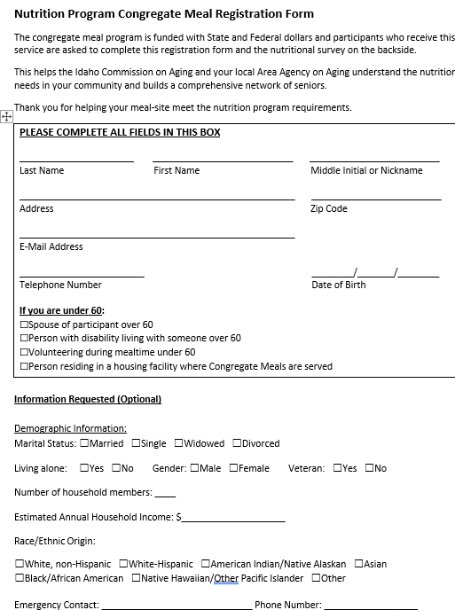
Congregate Meal Registration Form
Notes:
Check-in clerks should be able to assist consumers with forms, as needed.

Slide 11
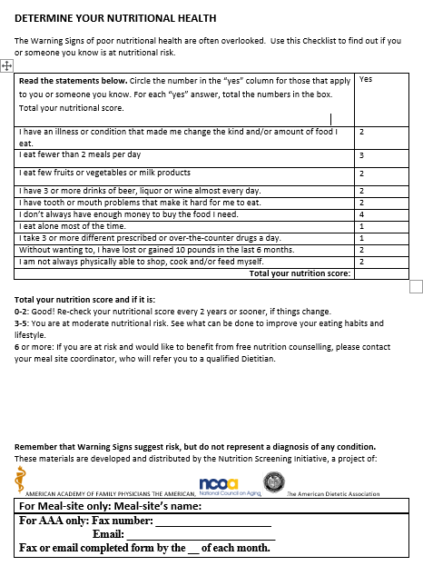
Nutritional Health Survey

Slide 12
the Nutritional Health Survey
Asks 10 yes/no questions
Each has score for a “yes” answer
Total score gives suggestions for
possible follow-up
  Individual on their own
  Coordinator
  Physician or Dietician with the person
Consumer scores a 6 or higher, can request a free
nutrition counseling session with the Dietician
Notes:
10 questions with score determining follow-up recommendation
If consumer scores 6 or more, that consumer is eligible for free nutritional counseling from the Dietitian
Important to instruct staff, especially check-in clerks, to notify Coordinator if scores >6 Then the Coordinator will inform their Dietician with the contact information and the approval of the client to do a one-on -one counseling by either calling the participant or in person. This is up to the Dietician.

Slide 13
Rosters & Sign-In Sheets
Provides required data for everyone 60+
including volunteers
Basis for monthly invoices
Required for participation reporting, program
funding & reimbursement
Reported to State Legislature & ACL
Sign-in sheets document non-qualified and those
who refuse to register
Notes:
Official required documentation for meal counts, invoicing, program reporting
Starting point of documentation path for reporting that allows AAA, ICOA, and the ACL to understand program utilization
This is why a simple process of registering a qualified person, so they are included on rosters is such an important activity

Slide 14
Rosters & Sign-In Sheets Capture
Rosters
  Quick check-in for registered consumers
  Standard format for data entry & documentation
Sign-in sheets capture all non-qualified people (under 60) &
visitors who prefer not to register)
Goal is to capture who is utilizing the program
Notes:
Rosters provide quick, formal meal count
Sign-in sheet tracks everyone under 60 that has to pay and /or visitors
Rosters provide standardized format for reporting and data-entry
Currently, allowed to use whatever system works for a meal site but must provide the standardized completed roster with the monthly invoice to AAA

Slide 15
Rosters & Sign-in Sheets
Rosters should be received electronically from AAA
prior to the start of the month
Should be used to capture participation at
meal service
Specific reporting requirements determined by AAA
Generally submitted at least monthly
Notes:
Completed as part of check-in, provided to AAA at least monthly

Slide 16
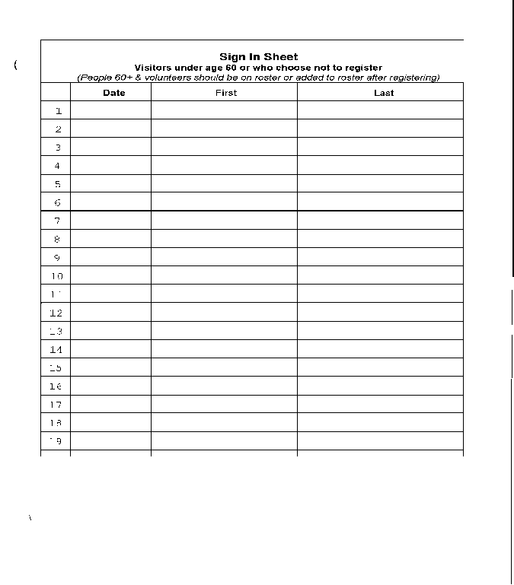
Complete Rosters & Sign-in Sheets
Use rosters to check-in previously registered
consumers & volunteers
Write- in names of people who register for the first time
Indicate their participation
for the current meal
Sign-in sheets
  People <60 or prefer not to register
  Meal site can charge
  people <60 for the meal
  unless Idaho Food Bank
  commodities are used, then
  cannot charge
Notes:
Indicate on roster at check-in, write-in newly registered and visitors use sign-in sheet
Can we charge for a meal? Clarify the rules for charging for meals. Will discuss charges in later focus area, but for now know that visitors can be charged for meals unless Idaho Foodbank commodities are used at the facility, then people cannot be charged. This is an important requirement.

Slide 17
Sample Roster
Service Unit Roster Daily - w/o Auth |  |  |  |  |  |  |  |  |  | Date range from Jan 1, 2023 to Jan 31, 2023 |  |  |  |  |  |  |  |  |  |  |  |  |  |  |  |  |  |  |  |  |  |  | Total
Report Description | Prints a monthly grid with space to note units on a daily basis. Has a total column to facilitate entering monthly units in Service Recording.
Region Contractor: | PSA
Service: | Home Delivered Meals
Provider:
Period: | January, 2023
Site: | Meal Provider Name
Client Name | T | Mo 01 | Tu 02 | We 03 | Th 04 | Fr 05 | Sa 06 | Su 07 | Mo 08 | TU 09 | We 10 | Th 11 | Fr 12 | Sa 13 | Su 14 | Mo 15 | Tu 16 | We 17 | Th 18 | Fr 19 | Sa 20 | Su 21 | Mo 22 | Tu 23 | We 24 | Th 25 | Fr 26 | Sa 27 | Su 28 | Mo 29 | Tu 30 | We 31
Adam Adamson |  | 1 | 1 | 1 | 1 | 1 |  |  | 1 |  | 1 | 1 | 1 |  |  | 1 | 1 | 1 | 1 | 1 |  |  | 1 | 1 | 1 | 1 | 1 |  |  |  |  |  | 19
Birgit Birgitson |  |  | 1 |  | 1 |  |  |  | 1 |  |  |  | 1 |  |  |  |  | 1 | 1 | 1 |  |  |  | 1 |  |  |  |  |  | 1 | 1 |  | 10
Jane Doe |  | 1 | 1 | 1 | 1 |  |  |  | 1 |  |  | 1 | 1 |  |  | 1 | 1 | 1 |  |  |  |  | 1 |  |  | 1 |  |  |  |  | 1 |  | 13
Gustav Gustavson |  |  | 1 |  |  | 1 |  |  |  | 1 | 1 | 1 | 1 |  |  | 1 | 1 | 1 | 1 | 1 |  |  |  | 1 | 1 | 1 | 1 |  |  |  | 1 |  | 16
James Jameson |  | 1 |  |  |  |  |  |  |  |  |  |  |  |  |  |  |  |  |  |  |  |  |  |  |  |  |  |  |  |  |  |  | 1
Thomas Smith |  |  |  | 1 | 1 | 1 |  |  | 1 | 1 |  |  |  |  |  | 1 | 1 | 1 | 1 |  |  |  |  | 1 | 1 |  | 1 |  |  |  |  | 1 | 13
ADD
(Volunteers)
(New Participants)
Total Meals |  | 3 | 4 | 3 | 4 | 3 | 0 | 0 | 4 | 2 | 2 | 3 | 4 | 0 | 0 | 4 | 4 | 5 | 4 | 3 | 0 | 0 | 2 | 4 | 3 | 3 | 3 | 0 | 0 | 1 | 3 | 1 | 72
Notes:
Review roster use

Slide 18
Follow Donation Guidance
Ensures everyone understands donations:
  Are voluntary
  No meal is ever denied based on a person’s choice to donate or not
Establishes donor privacy & confidentiality
Relieves consumer concern that donations are being monitored
Provides staff & volunteers confidence that they are adequately
prepared to work with donations
Notes:
Ensure voluntary, private, secure donation opportunities and quality customer service
Important when dealing with public funds to ensure the utmost of adherence to any designated procedures related to activities
No meal can ever be denied based on a person’s choice to donate or not
Guidance establishes donor privacy and confidentiality

Slide 19
Best Practice
The donation box must be located in a place where confidentiality and privacy is given
Preferred is a spot where participants have to go behind the box to donate
Ideally the box is protected from three sides, and located that there is a wall behind the person that will donate.
The donation box cannot be at the entrance door, nor close to the sign in table

Slide 20
Donations
Donation box should be available:
  During all service times
  Reasonable amount of time before & after service
Should be counted, recorded & secured at least daily
Notes:
It is highly recommended that donations will be counted with two people being present.

Slide 21
Ensure Proper Donation
Processes
For each service:
  Donation box properly placed & secured
  Voluntary contribution amount clearly posted
  Staff & volunteers properly trained on donation guidance &
  approved procedures
  Privacy provided
“Under no circumstances may a Nutrition Provider deny services
to an eligible consumer because of the consumer’s inability or
choice not to make a contribution or donation to the program.”

Slide 22
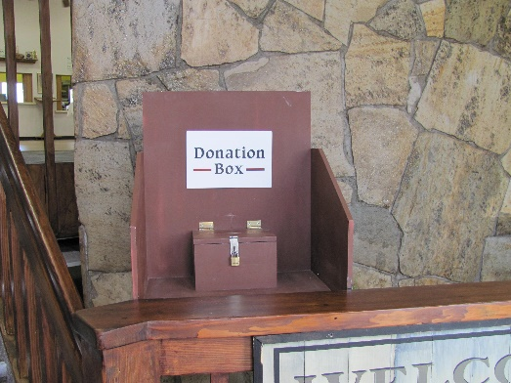
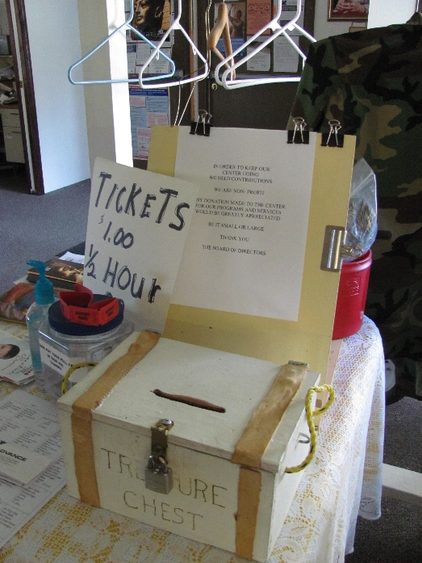
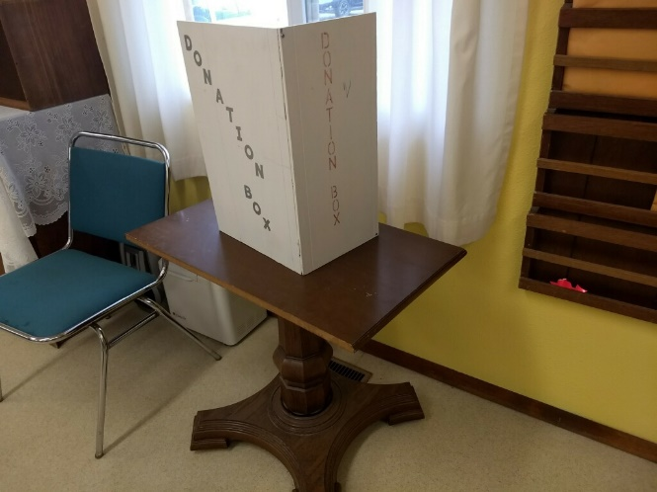
Which Image(s) Follow Guidelines?

Slide 23
Complete Donation Tracking Sheets
Voluntary Contributions/Donation Guidance
  Written procedures established & implemented
  safeguard & account for fees & donations:
  Two persons count each day
  Both sign a for correct amount
  Copy kept on file
  Sealed daily & deposited or secured until deposited
  Deposit receipts reconciled by someone other than person responsible
  for making deposits
All funds with documentation reported to Coordinator who
  Seals the donations
  Checks for written acknowledgement
  Makes the deposit
Notes:
Process is intended to safeguard and account for the fees and donations received and ensure they are appropriately credited to the related programs
The same person can perform more than one task of the donation process, but they cannot be tasked with completing two activities in a row. For example, they cannot both make the deposit and check the deposit slip against the bank statement.
NOTE: if smaller meal sites are concerned about the personnel required to complete this, remind them that a staff member or volunteer can count the money, the coordinator can seal and deposit the money, and the same staff member or volunteer could then reconcile the deposit receipt. Because the coordinator completes a step between the initial count and the reconciliation, this still meets the minimum requirements.
Intention is to protect any person from ever having their actions questioned.
This policy has been in place but has not been fully enforced in the past. All meal sites need to review their current procedures and make sure that they are complying.

Slide 24
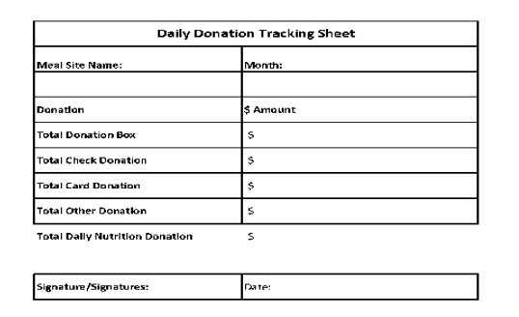
Daily Tracking Sheet Example
Notes:
Review Daily Tracking
Tracking sheets could be standardized

Slide 25
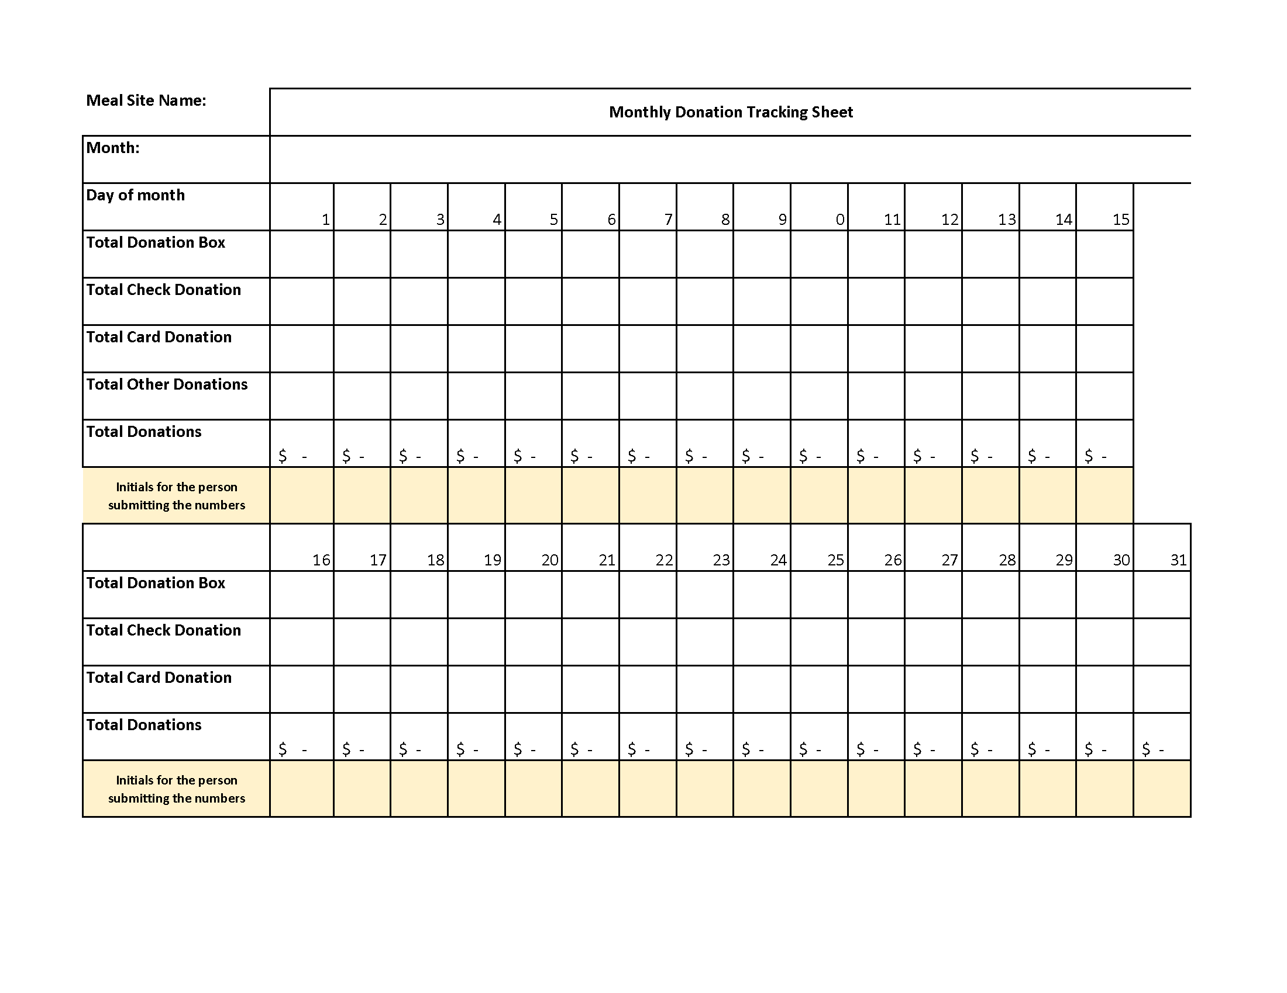
Monthly Tracking
Sheet
Notes:
Use template provided in toolkit

Slide 26
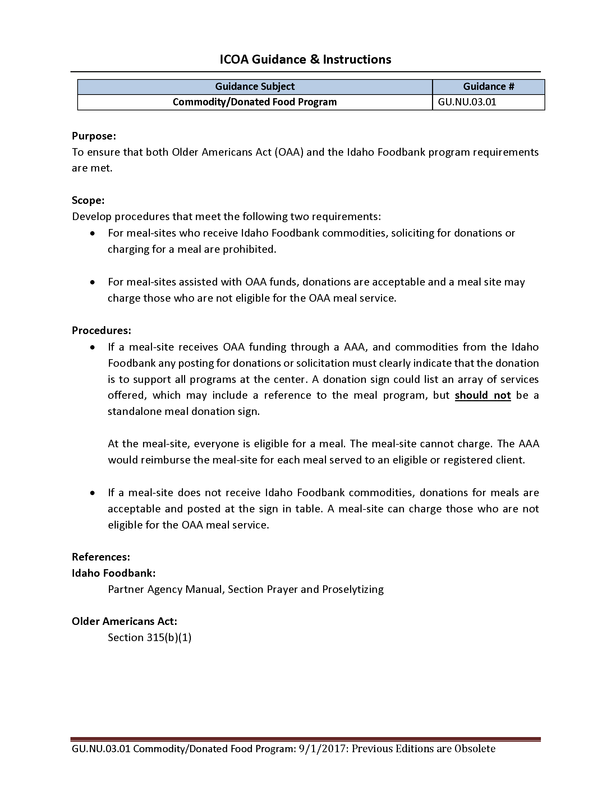
Commodity Donated Food
Guidance (GU.NU.03.01) Includes
Addresses ICOA & Idaho Foodbank requirements
Identifies how procedures must
be defined
Addresses solicitation &
acceptance of donations &
meal charges related to Foodbank
commodity use
Review full guidance for
complete details
Notes:
Cannot charge for meals that use commodity donated food

Slide 27
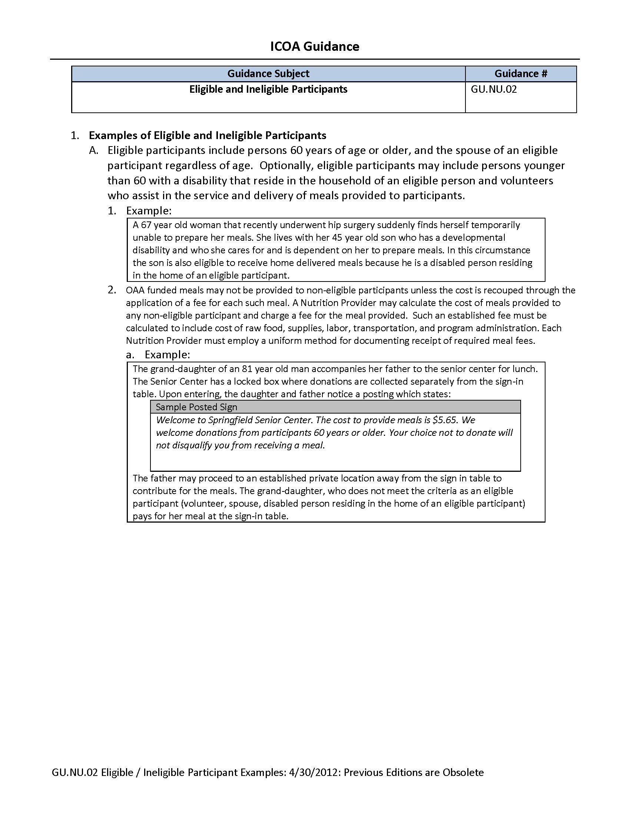
Eligibility Guidance (GU.NU.02)
Includes
Identifies who is eligible to
receive meals
Provides examples & scenarios
Lists sample donation sign text
Review full guidance for
complete details

Slide 28
HDM Guidance(TG.NU.01) Includes
Ensure that HDM are safely, sanitarily
delivered to & received by consumer
AAA must have fair & equitable
meal delivery policy that outlines
consumer duty for delivery
  Process for notifications
  Requirements to terminate delivery
  service to consumer
Review full guidance for
complete details

Slide 29
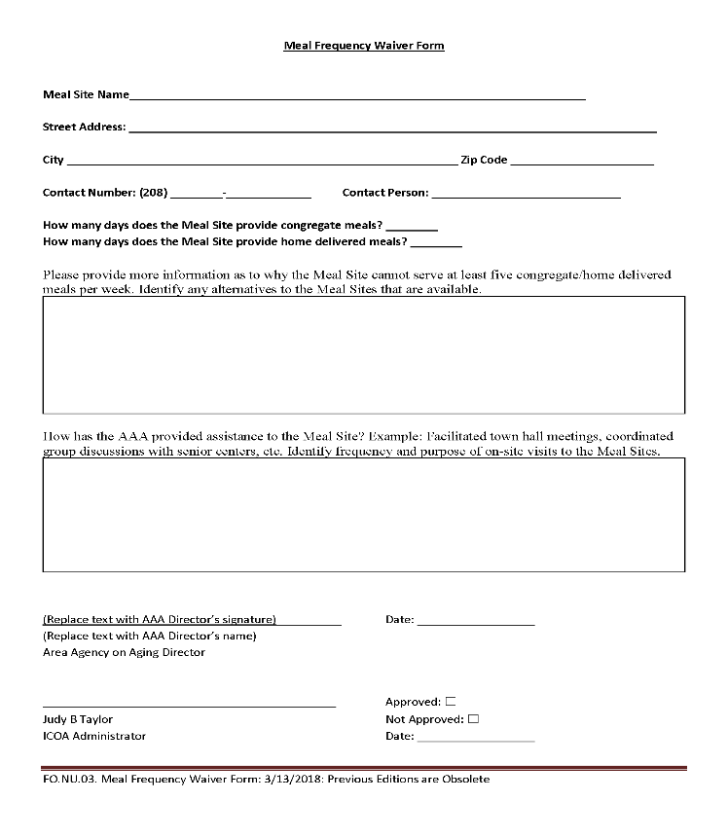
Meal Frequency Waiver Guidance
Includes
Meal sites required to provide at
least five meals per week
Form required if unable to comply
  Meal site location & contact information
  Number of congregate & HDM meals
  provided each week
  Explanation of inability to provide
  required meals
  Suggested alternatives
  Description of how AAA has assisted
Requires signature of AAA
Director & ICOA Administrator
Review full guidance for
complete details
Notes:
Coordinators need to know guidance and ensure they and their staff follow as standard practice.
Know & follow guidance
Be able to refer to & quickly access actual guidance,
electronically or in hard copy
Guidance updates provided to coordinator by AAA with
updated document via e-mail
Work with your AAA nutrition staff to resolve questions

